Slide 1
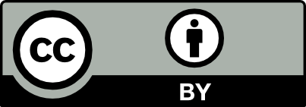
Intro to the Mu Editor and Python
Unit 2 Lab 0

Slide 2
The Mu IDE
IDE = Integrated Development Environment
Written in Python
A simple development environment for Python
Targets educational use
Notes:
Developed by Nicholas H.Tollervey - https://ntoll.org/
https://codewith.mu/en/ - main website
https://mu.readthedocs.io/en/latest/ - documentation website

Slide 3
Typical IDE Features
Source file editor - create, save and modify source files
Run automation - One button run of source file
Debuggers - Ability to create breakpoints and step through code line by line

Slide 4
More Mu IDE Features
Multiple Python version support by selecting Mode
Built-in data plotter
One click access to Python REPL
Check and Tidy options
Notes:
Check will highlight syntax errors prior to user running the program.
Tidy will clean up syntactically correct code to have consistent spacing for enhanced readability.

Slide 5
Mu IDE and Python REPL
REPL = Read Evaluate Print Loop
Python is an interpreted language
The interpreter Reads a line of code, Evaluates the line of code, Prints any output and Loops
REPL provides quick access to the interpreter for quick code checks

Slide 6
Python Big Ideas
6 Basic programming abilities
Do math
Inputs
Outputs
Make and use variables
Make decisions (If-then conditional statements)
Repetition / Loops
Notes:
These 6 basic programming abilities are found in every programming language.
These can be combined to create algorithms to solve problems.

